Slide 1
MSc INDIVIDUAL PROJECT — SCHOOL OF ELECTRONIC & ELECTRICAL ENGINEERING
Monte Carlo Modelling of X-ray Generation and Detection in EDXS of GaAs₁₋ₓBiₓ Alloys in a TEM
Assessing whether routine EDX spectroscopy can reliably quantify bismuth content — or whether characteristic-line overlaps are quietly corrupting the answer.
Ethan Anthony Pratt
Supervisor: Dr Thomas Walther
Department of Electronic and Electrical Engineering
The University of Sheffield • August 2026

Slide 2
Overview
1
Background & Motivation
The material, and why measuring it is hard
2
Aims & Objectives
What this project set out to determine
3
Outline Theory
What degrades the spectrum before it is measured
4
Simulation Methodology
Monte Carlo modelling of X-ray generation & detection
5
Results & Discussion
Which line — and when — gives reliable Bi quantification
6
Conclusions & Future Work
Recommendations and next steps

Slide 3
Background & Motivation
1
The appeal
Bi narrows GaAs's bandgap & cuts temperature drift
→ valuable for infrared (IR) optoelectronics · lattice strain: an accepted trade-off, not the goal
Demonstrated in this department: avalanche photodiodes at a few percent Bi
→ noise parameter falls 0.48 (GaAs) → 0.2 at 4% Bi; silicon-comparable by 3.5% Bi
→ absorption extends past 1.1 µm into the near-infrared (Liu et al., 2021)
2
The stakes
Energy
Bandgap narrows with
increasing Bi content
Benefit is front-loaded, cost accelerates
→ most band-structure change is banked in the first few percent
→ strain energy grows with the square of the misfit
→ so working devices live in the dilute window
— a few percent Bi
3
The catch
Routine EDX quantification of Bi can be misleading
→ X-ray line overlaps corrupt the signal (2025 study)
GaAs
GaAs₁₋ₓBiₓ
→ shifts emission into the infrared

Slide 4
Aims & Objectives
AIM
Build a Monte Carlo framework for X-ray generation, attenuation & detection in GaAs₁₋ₓBiₓ thin foils — to find the most reliable X-ray line pairs for quantifying Bi
1
BASIC
2
BASIC
Material rationale
Specimen geometry
Analyse strain & bandgap
bowing in GaAsBi
Model free-standing foils
(25° take-off, no substrate)
3
ADVANCED
4
ADVANCED
Signal attenuation
Parameter sweep
Characterise absorption vs
thickness & Bi content
Sweep in Python → most
reliable line pair

Slide 5
OUTLINE THEORY
What degrades the spectrum before it is measured
Two X-rays arrive at the same instant and are recorded as one, carrying their combined energy — landing on Bi Mα, so it fakes the signal being measured. This is the sum peak.
Both overlaps measured against the detector linewidth — two peaks closer than about one linewidth merge into a single bump
Sum peak → Bi Mα
43 eV apart
MERGED
0.47 FWHM
As Kα₁ vs Bi Lα
297 eV apart
RESOLVABLE
1.75 FWHM
Sum peak = bias — systematically wrong in one direction
Overlap = variance — noisier, but unbiased

Slide 6
① METHODOLOGY
Running the code is the easy part
Almost every way of getting it wrong produces a result that looks completely normal.
21 simulations × 6 input files each
01
02
03
Units
Composition
Density
Ångströms, not nanometres
— the manual says otherwise
Weight fraction,
not atomic fraction
Must be set explicitly, or
elemental densities auto-mix
None of these throw an error.
THE GATE
Every generated input diffed byte-for-byte against a validated reference
Faults injected deliberately — 5 of 5 caught · 304 tests green

Slide 7
② METHODOLOGY
Nothing invented
Every physical constant traces to a source — or the code stops.
The one worth naming: density
Both codes estimate it by interpolating elemental metal densities
→ GaAsBi is covalently bonded — silently the wrong physical picture
ρ(x) = 5.32 + 1.86x
endpoints 5.32 (GaAs) and 7.18 (hypothetical GaBi), interpolated
On Prof. Walther's advice — updates the values in his own published paper

Slide 8
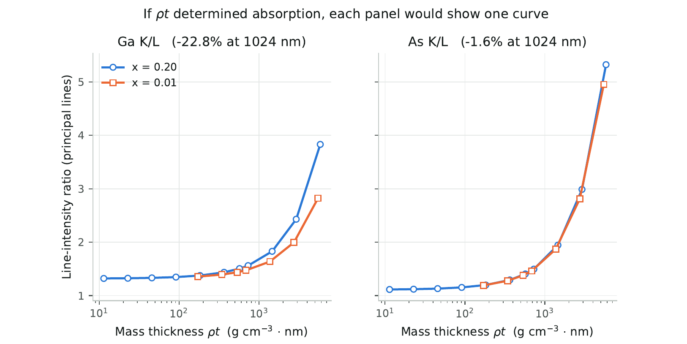
③ METHODOLOGY
The matrix grew because a measurement told it to
A cross assumes you can fill in the middle — that what matters is how much material the beam crosses (thickness × density). Tested rather than assumed, and it failed: 23% wrong at 1 µm.
Not a density error — the offset stays constant while the error grows 17-fold → third arm added at x = 0.01
Compared at matched thickness: gallium's brightness ratio also tracks composition (26.3%); arsenic's barely does (7.0%) → use arsenic as the ruler

Slide 9
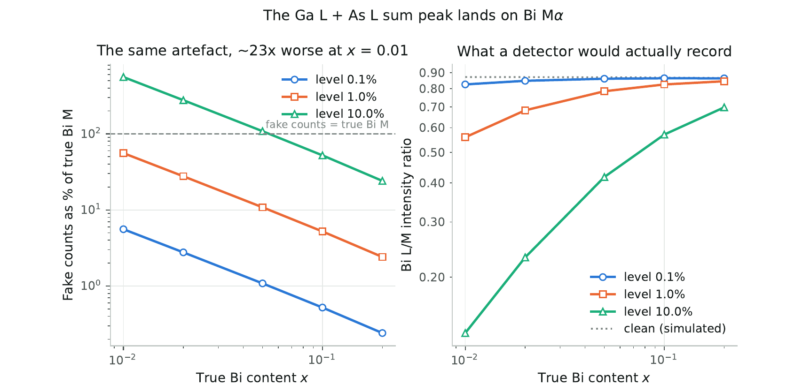
① RESULTS & DISCUSSION
What corrupts the measurement
The sum peak is selective, and it selects against the samples that matter
At 1% pile-up, fake counts on Bi Mα are
56% of the true Bi M signal at x = 0.01
2% of the true Bi M signal at x = 0.20
→ the same artefact, 23× worse at the low end
Why: the Ga and As signals feeding it are ~100× stronger than Bi M in a dilute sample, but only ~5× stronger in a rich one — a small leak from a large pool into a small one
Counting statistics — a real acquisition holds finitely many photons
116 detected Bi Lα · 76 detected Bi Mα · at x = 0.01, 100 nm
Not the same size, and not the same kind: counting noise is symmetric and shrinks with time — the sum peak is a bias that does not

Slide 10
② RESULTS & DISCUSSION
What survives it
Three mechanisms, three incompatible units → one currency: error on recovered composition
Nothing unknown gets a default
27
scenarios swept — 3 pile-up levels × 3 overlap couplings × 3 doses
16
switch combinations for the sum peak — route ordering identical in every one
Measurable across the full composition range, against Walther's accuracy bar Δx = 0.01 — an error of no more than 0.01 in composition
Bi L
27 / 27
Bi K
9 / 27
Bi M
0 / 27
Outside the simulated range the code reports which side the answer fell on — it does not extrapolate

Slide 11
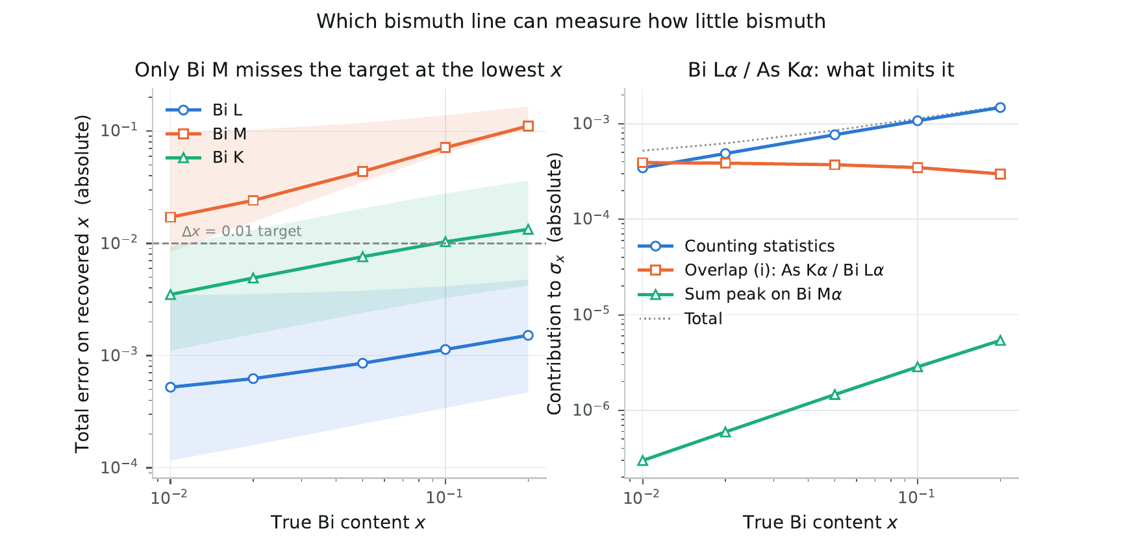
① CONCLUSIONS & FUTURE WORK
The verdict
RECOMMENDED LINE PAIR
Bi Lα measured against As Kα
single strongest line of each · x ≈ 0.01 · 27/27 scenarios pass · Walther's 715.5 s acquisition

Slide 12
② CONCLUSIONS & FUTURE WORK
Why it holds
The other candidates fail for reasons that do not go away
Bi M
sum peak — detector artefact
that fakes counts on the line
Fails all 27 · a bias, so longer
acquisition cannot cure it
Bi K
range — clears at low Bi,
but not across it
Fails 18 of 27 · Bi L never
crosses in any
Bi L
overlap (i) — the As / Bi
line overlap
Passes all 27 · worst case 0.0034 in x
— a quantity measured, not a gap
ROBUST THREE WAYS
Both accuracy bars
Δx = 0.01 (Walther)
& 10% relative
Both line definitions
raw ratios differ
40–90%
Verified 32–1024 nm
transfer residual
< 2 × 10⁻⁷ in x

Slide 13
③ CONCLUSIONS & FUTURE WORK
Limitations & future work
1
Overlap coupling swept (0.1 / 1 / 10%), not measured — the verdict survives the worst case
2
Detection floor below x = 0.01 not bracketed — two more runs would find it
3
Bi M discrepancy between two independent codes (1.506 ± 0.020) — bounded, not explained
None of these touch the recommendation — but they are the honest next steps.

